Slide 1


Department of Computer Science and Engineering
CS19643 – FOML
GPA PREDICTION USING REAL TIME DATA
HARISH S-210701073
HARISH D-210701077
KAARNESH V-210701100

Slide 2
Problem Statement and Motivation
The problem addressed in this research is the accurate prediction of students' Grade Point Average (GPA) using supervised learning models, specifically decision tree algorithms. This study aims to identify the key factors influencing GPA, such as department, professor, and midterm exam grades, to predict academic performance. The motivation behind this research is to enhance early detection of at-risk students, thereby enabling timely interventions and support. By leveraging data-driven insights, the study seeks to improve educational outcomes, facilitate informed decision-making in higher education, and ultimately enhance student success and institutional management.

Slide 3
Objectives
The objective of this research is to integrate supervised learning models, particularly decision tree algorithms, for the prediction of Grade Point Average (GPA) in students. By comparing current academic performance with previous years, and conducting statistical analyses on questionnaire data, the research aims to monitor students' progress and predict their understanding across various subjects. The study investigates the relationship between internal marks and GPA, demonstrating the significant impact of these models on college placement outcomes. Ultimately, the research seeks to enhance decision-making in higher education by identifying students at risk of academic failure through data-driven analysis.

Slide 4
Abstract
The integration of supervised learning models for grade point average (GPA) prediction is the subject of this research. We compare their academic performance this year to previous years and look at their statistics. A statistical analysis is performed to evaluate the questionnaire data. We monitor students' progress year after year and can predict their degree of understanding in a variety of subjects and fields. Based on the investigation, a somewhat substantial dependence between the components and the GPA was discovered. The models predict the GPA based on independent variables. Internal Marks are percentages or marks that are used to assess a student's knowledge and abilities over the course of their schooling. Machine learning under supervision and decision tree algorithms are typically completed in this manner. Additionally, the college and the student's placement are impacted by the model's generated outcome. The forecasts were based on just three categories of criteria: department, professor, and grades from midterm exams. These forms of data-driven studies are essential for helping with decision-making and for creating a framework for learning analysis in higher education. In summary, this research highlights the most effective machine learning strategies and significantly advances the early identification of students who are most likely to fail.

Slide 5
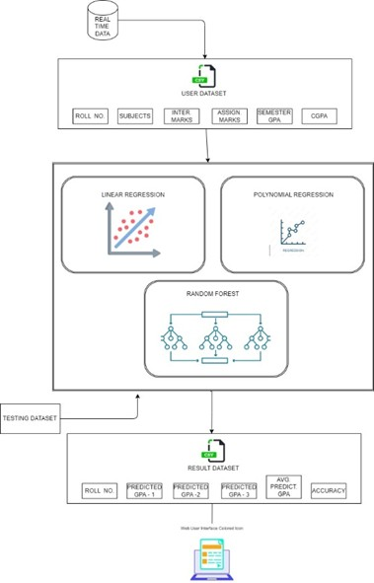
System Architecture
REAL TIME DATA :
The architecture diagram illustrates a comprehensive system designed for predicting student GPAs using multiple machine learning models. The process begins with the user dataset, which is derived from real-time data and includes various student-related attributes such as roll number, subjects, internal marks, assignment marks, semester GPA, and CGPA. This dataset serves as the foundation for training the machine learning models. Three machine learning models are employed in this architecture: Linear Regression, Polynomial Regression, and Random Forest. Linear Regression is a simple yet powerful model used to establish a linear relationship between the dependent variable (GPA) and one or more independent variables (internal marks, assignment marks, etc.).

Slide 6
System Architecture
Machine learning models:
Regression that adds higher-order terms to support deeper conversations. When there is a nonlinear relationship between the variables, this model might be helpful in capturing details that linear regression could ignore. One potent machine learning model known as the Random Forest Block as an assortment of decision trees, or a random forest. In this case, the roll number, subjects, internal marks, assignment marks, semester, and COPA would be used in the training phase of the random forest model with the user dataset block so as to forecast the student's GPA. Since they are strong against overfitting and adept at handling intricate data connections, random forests are a useful tool for exact GPA prediction in educational systems.

Slide 7
List of Modules
DATA PRE-PROCESSING:
This module mainly consists of the preliminary step of collecting crime files from various states and conversion of cleaning the image size by rescaling it to a proper and standard size. To reduce the number of dimensions of the data the image is turned to black and with using binarization for separation of background with foreground which contributes to removal of noise.
TRAINING SET:
By using the comprehensive models of Capsnet and Resnet, the handwritten case files are converted to a digital format which will later be fed to a machine learning algorithm for clustering. This is a very important step as this step involves changing handwritten text of various regional languages to digitalized format.

Slide 8
List of Modules
TRAINING MODEL:
The system is then trained with an ensemble model of various clustering algorithms like K Means, DBSCAN and Hierarchical clustering. Based on the various features of crime, clusters are formed. The dataset given to this model is the digitalized case files that have been solved, collected across various states.
PATTERN MATCHING:
When a new case file or an existing unsolved case file is fed to the system, the case file associates itself to the closest possible cluster and based on the output of pattern matching of certain key features, the cluster is recognized and the case files from that cluster is returned which can serve as a breakthrough for the investigation.

Slide 9
Implementation/Results of Module
Statistical Analysis:
Three machine learning models—Linear Regression, Polynomial Regression, and Random Forest Analysis—were investigated in this study for their ability to predict student GPAs. By using a 70-30 split ratio to divide the dataset into training and testing sets, robust evaluation was ensured. A significant linear link between the traits and the GPA was demonstrated by the Linear Regression model's R2 score of 0.75. Due to its capacity to capture non-linear associations, the Polynomial Regression model—which increases complexity by taking into consideration polynomial terms—produced an R2 score of 0.80, indicating improved results. With an R2 score of 0.85, the Random Forest Regression model—an ensemble learning technique—showcased its superior ability to cope with intricate data patterns and minimize overfitting by employing multiple decision trees.

Slide 10
Implementation/Results of Module
To evaluate the accuracy and transportation of predictions, graphical plots of the actual vs predicted GPAs for each model were created. The combined plot showed that Linear Regression, Polynomial Regression, and Random Forest Regression had the closest alignment to the real GPA values. The effectiveness of ensemble approaches in educational data mining is highlighted by this analysis, and it additionally emphasizes the significance of model selection to get precise GPA forecasts. The conclusion that Random Forest Regression is the most reliable model for this application is reinforced by the quantitative and visual results, which makes it a useful tool for educational institutions looking for ways to predict and improve student performance.

Slide 11
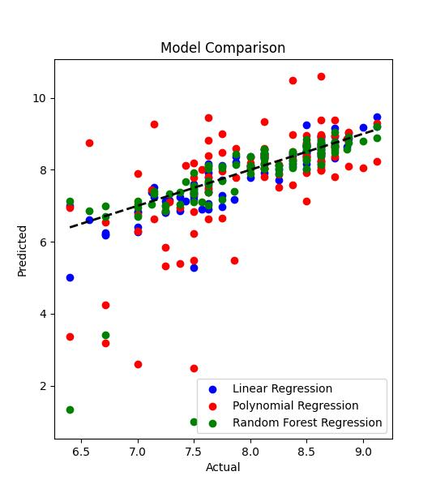
Implementation/Results of Module
A vital component of assessing the way machine learning models work is the testing dataset block. It consists of a carefully chosen part of the user dataset that has not been used to train any models. Rather, the testing dataset functions as an anchor point to evaluate how effectively the models extend to data that is not observed. We recreate real-world instances where the model encounters fresh information by withholding this element during training. This procedure aids in assessing the model's capacity for precise making forecasts and helps prevent overfitting, which happens when the model performs well on training data but badly on fresh data. We can quantify the accuracy, precision, recall, and other performance measures of the machine learning models with confidence because of thorough testing on this independent dataset, which offers insightful data into their resilience and practical application.

Slide 12
Conclusion
In general, an important advance in educational data analytics has been made with the incorporation of supervised learning approaches, specifically decision tree algorithms and neural network techniques, for the purpose of forecasting GPA. The research underlines how crucial it is to include a wide range of comprehensive educational traits to improve the efficacy and accuracy of GPA prediction models. These parameters include departmental resources, faculty knowledge, midterm test grades, and internal marks. Through the utilization of these algorithms' predictive powers, educational establishments can promptly detect students who are deemed to be at-risk, allowing for customized interventions that cater to each student's unique academic requirements and cultivate a supportive learning atmosphere. Implementing data-driven strategies also makes it easier to make choices based on evidence, which enhances student support services and institutional management.

Slide 13
References
[1] Stephen D.H. Hsu (Dept. of Physics, Univ. of Oregon), James Schombert (Dept. of Physics, Univ. of Oregon) ( 2010 April 15). Data Mining the University: College GPA Predictions from SAT Scores. https://arxiv.org/abs/1004.2731
[2]Phillippa Poole,Boaz Shulruf, Joy Rudland & Tim Wilkinson (2012).Comparison of UMAT scores and GPA in prediction of performance in medical school: national study.https://asmepublications.onlinelibrary.wiley.com/doi/pdf/10.1111/j.1365-2923.2011.04078.x
[3]Raden Gunawan Santosa , Yuan Lukito , Antonius Rachmat Chrismanto(2021). Classification and Prediction of Students’ GPA Using KMeans Clustering Algorithm to Assist Student AdmissionProcess. https://pdfs.semanticscholar.org/f69a/a6d5634cc93264c85423bce8a1b0f7302b6c.pdf
[4]Rogers Elliott, A. Christopher Strenta (1988). Effects of Improving the Reliability of the GPA on Prediction Generally and on Comparative Predictions for Gender and Race Particularly. https://onlinelibrary.wiley.com/doi/abs/10.1111/j.1745-3984.1988.tb00312.x

Slide 14
Github and Drive Links
Drive Link:
https://drive.google.com/drive/folders/1SA9eFFMzAPaaTqp72BvZtpUuVADRZFkh
Github Links:
1. https://github.com/harishdhrd073/210701103-CS19643-FOML-Lab
2. https://github.com/
3. https://github.com/

Slide 15
Thank You

